Slide 1
“Wine is sunlight, held together by water” - Galileo

Slide 2
Benefits of Wine
Health Benefits
Polyphenols - to fight against free radicals
Flavonoids - to improve cardiovascular health.
Resveratrol content - to enhance memory.
Social Benefits
Interacting with your colleagues at work.
Dealing with your neighbours.
Hanging out with your circle of friends
Meeting new people.
Probably that is why the Wine industry shows a recent growth spurt & social drinking is on the rise.

Slide 3
The price of wine depends on a rather abstract concept of wine appreciation by wine tasters.
A Master Sommelier Diploma Exam is considered the toughest exam in the world .
This exam is a wine-tasting test for expert winemakers.
There are roughly 269 Master Sommeliers in the world today.
The median sommelier salary in the U.S across 4 levels of certification is $62,000.
A beginner sommelier makes roughly $40,000 - $50,000.
At level 2 this number goes to $60,000 - $70,000.

Slide 4


Vintest Wines
American Wine Company
Planning to enter the Indian market to make the most out the this recent growth spurt.
However due to limited availability of their Master Sommelier, they intend to use AI as an Advanced and effective solution to find out the best ingredients that suite the local palate and the weather in the shortest possible time.

Slide 5
We perform an EDA to determine how we can help Vintest
Let’s start by looking at the Dataset

Slide 6
For the markets in the U.S Vintest has collected data over the past few years that connects human quality of tasting to laboratory-based physiochemical tests.

Slide 7
Data Acquisition & Description
Fixed Acidity
Volatile Acidity
Citric Acid
Residual Sugar
Chlorides
Density
Most Acids Involved with wine or Non -Volatile Acids
Amount of acetic acid in wine which at high levels can lead to unpleasant taste
Adds freshness and Flavour to Wine
Remaining Sugar after Fermentation Stops
The amount of Salt in th Wine
Depemds on Alcohol & Sugar

Slide 8
Data Acquisition & Description
Total SO2
Free SO2
Sulphates
pH
Alcohol
Quality
Prevents microbial growth & Oxidation of Wine
Above 50 ppm becomes evident in nose and taste
Additive that contributes to SO2
Describes how Acidic or Basic the Wine is
Content of Alcohol in Wine
Rating Received from 1-10

Slide 9
Preparing Data
Redundant Data, Inconsistent Data, Outliers, Missing Values, Zeros, Univariate Analysis, Multivariate Analysis.

Slide 10
Roadmap
Oenology of Wines
Data Information
Data Pre-Processing
1
3
5
2
4
6
Data Description
Data Pre-Profiling
Data Post-Profiling

Slide 11
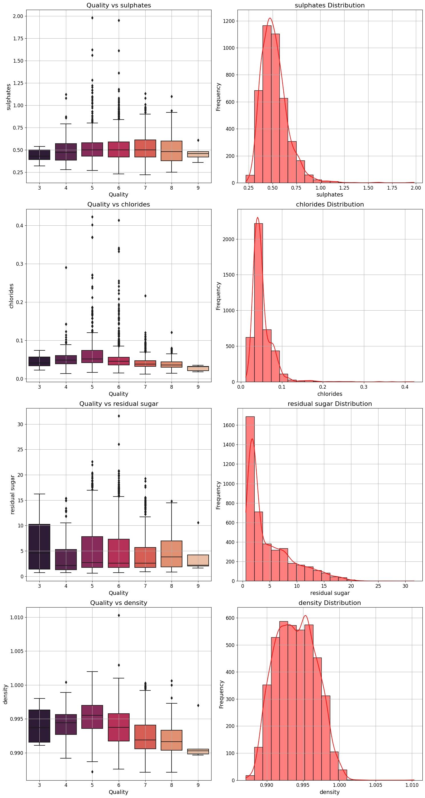
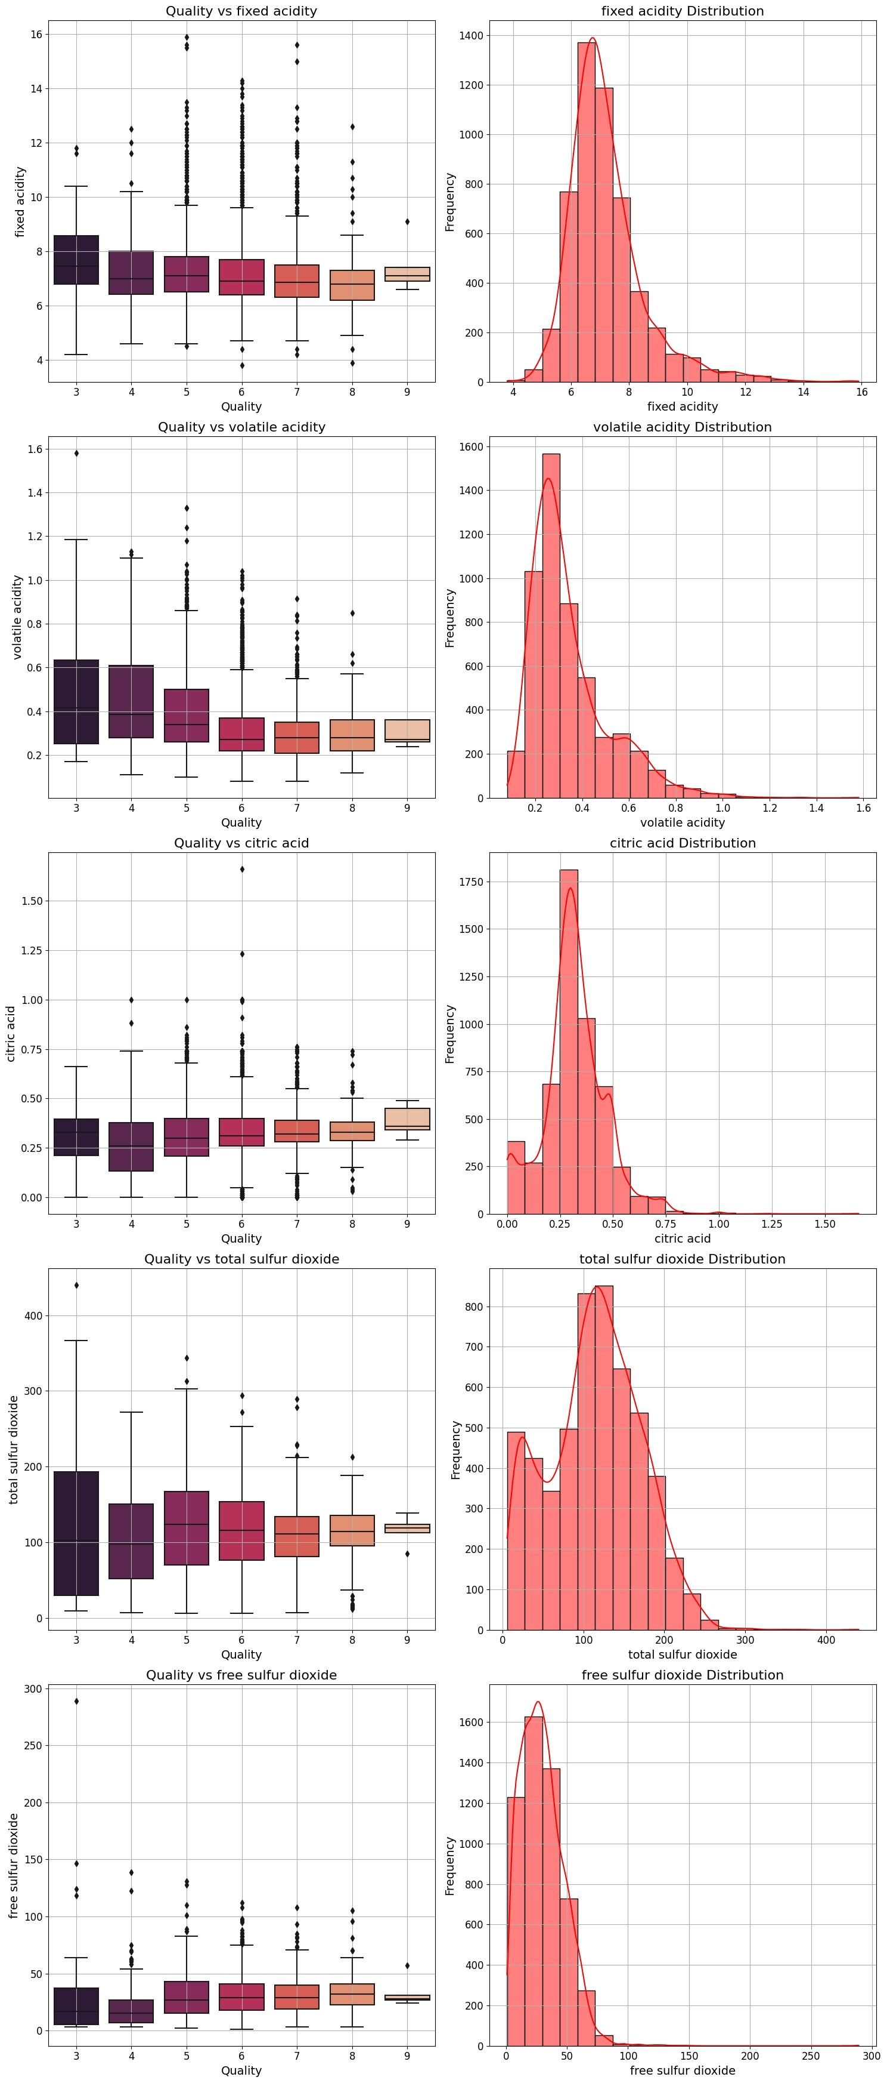
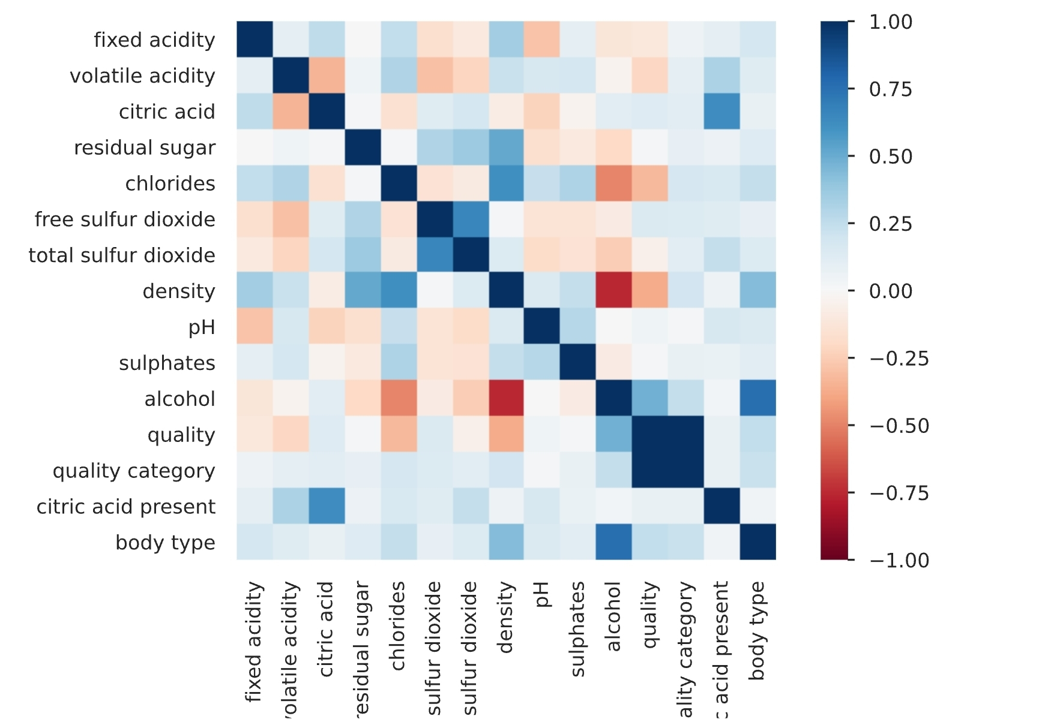
Pre-Profile Report

Slide 12
3 Features
1,191
1,559
Added (Presence of Citric Acid, Quality Category, Wine Body Type)
Duplicate Rows removed
Outlier & Inconsistent data points removed

Slide 13
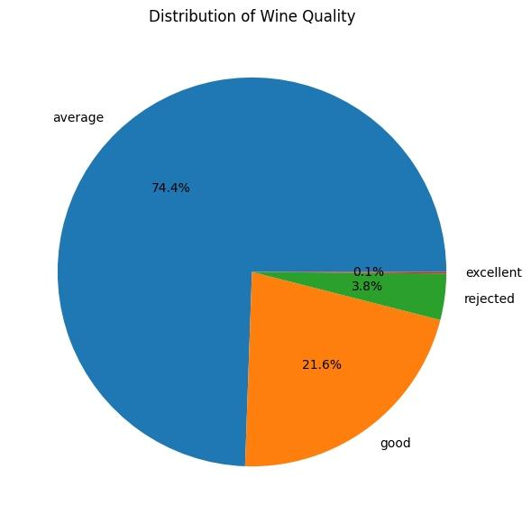
Breakdown of the distribution of wine quality in the dataset
Ratings 4 and below -Rejected – 3.8%
Rating 5 & 6 – Average – 74.4%
Ratings 7 & 8 – Good – 21.6%
Rating 9 and Above – Excellent – 0.1% (5 in Number)

Slide 14
Ingredients in the best wines?
Sr. No | F.A | V.A | Residual sugar | Chlorides | Free SO2 | Total SO2 | Density | pH | Sulphates | Citric acid | Body Type
2373 | 9.1 | 0.27 | 10.6 | 0.035 | 28 | 124 | 0.997 | 3.2 | 0.46 | Yes | Light
2419 | 6.6 | 0.36 | 1.6 | 0.021 | 24 | 85 | 0.989 | 3.41 | 0.61 | Yes | Medium
2426 | 7.4 | 0.24 | 2 | 0.031 | 27 | 139 | 0.990 | 3.28 | 0.48 | Yes | Medium
2475 | 6.9 | 0.36 | 4.2 | 0.018 | 57 | 119 | 0.989 | 3.28 | 0.36 | Yes | Medium
3204 | 7.1 | 0.26 | 2.2 | 0.032 | 31 | 113 | 0.990 | 3.37 | 0.42 | Yes | Medium

Slide 15
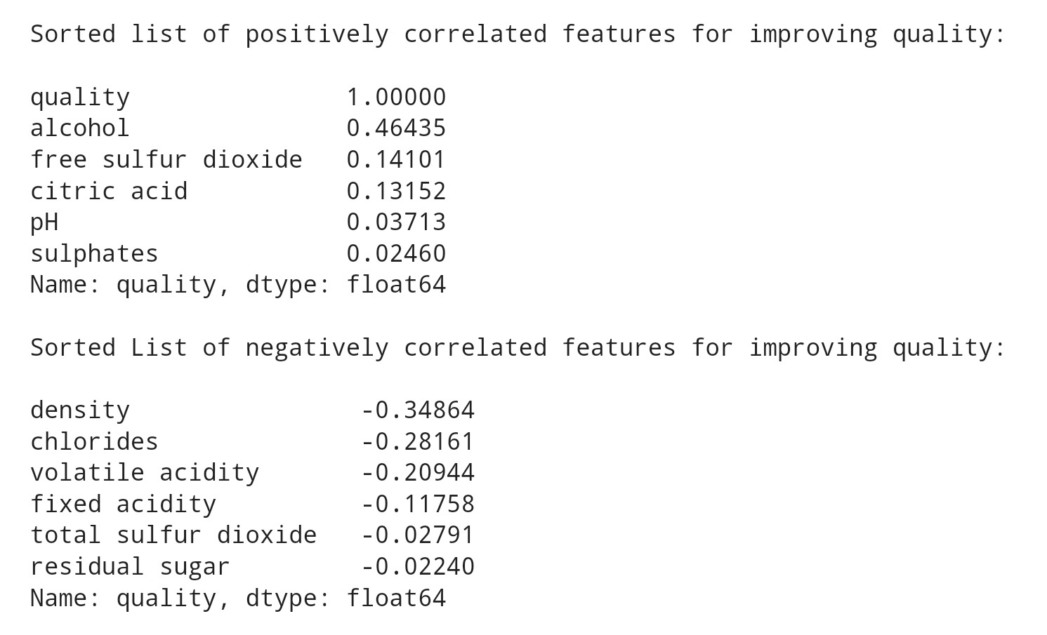
How each ingredient affects the quality of the wine?

Slide 16
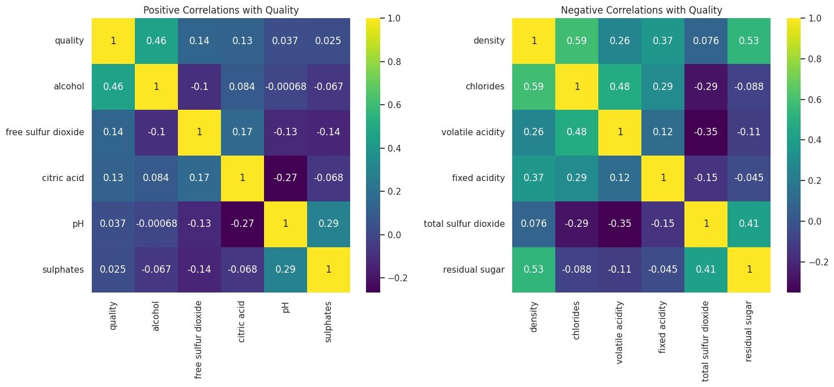
Which ingredient to focus on?

Slide 17
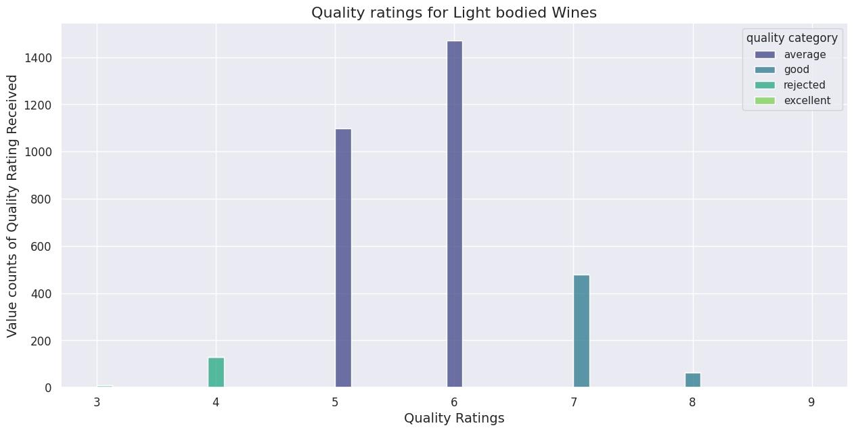
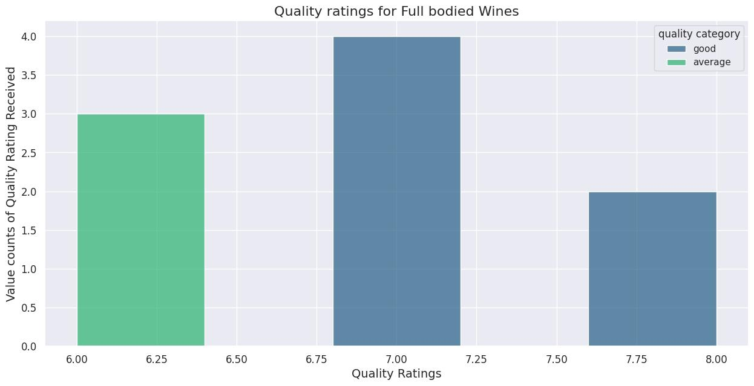
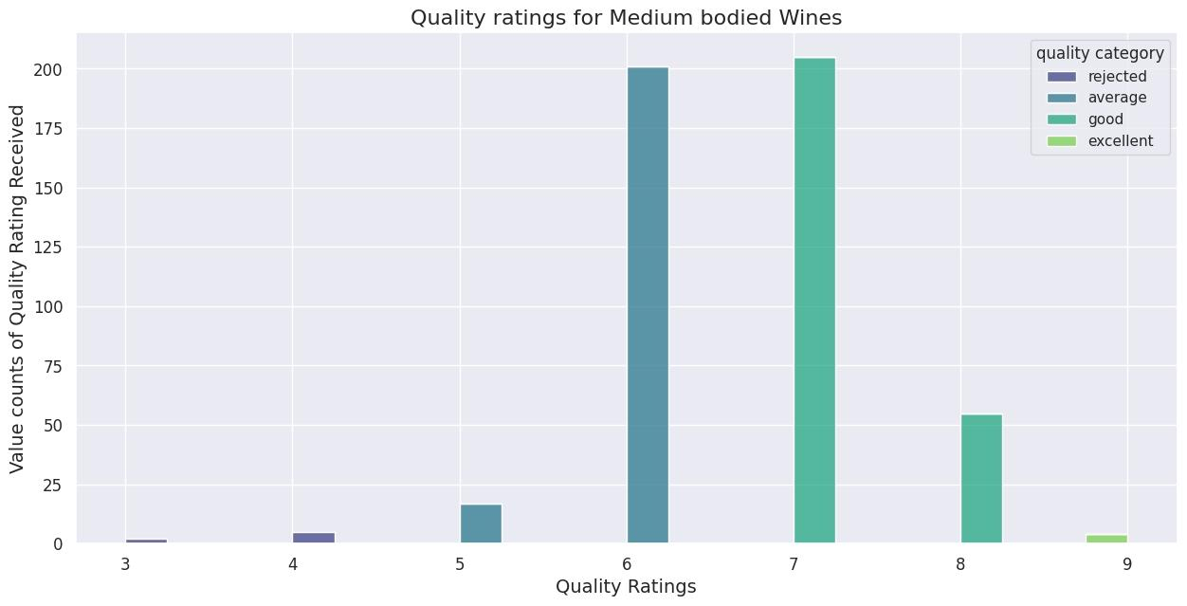
How is the quality affected by the Body Type of Wine?
Light bodied – Less that 12.5% Alcohol
Medium bodied – Between 12.5 – 13.5% Alcohol
Full bodied – More than 13.5% Alcohol

Slide 18
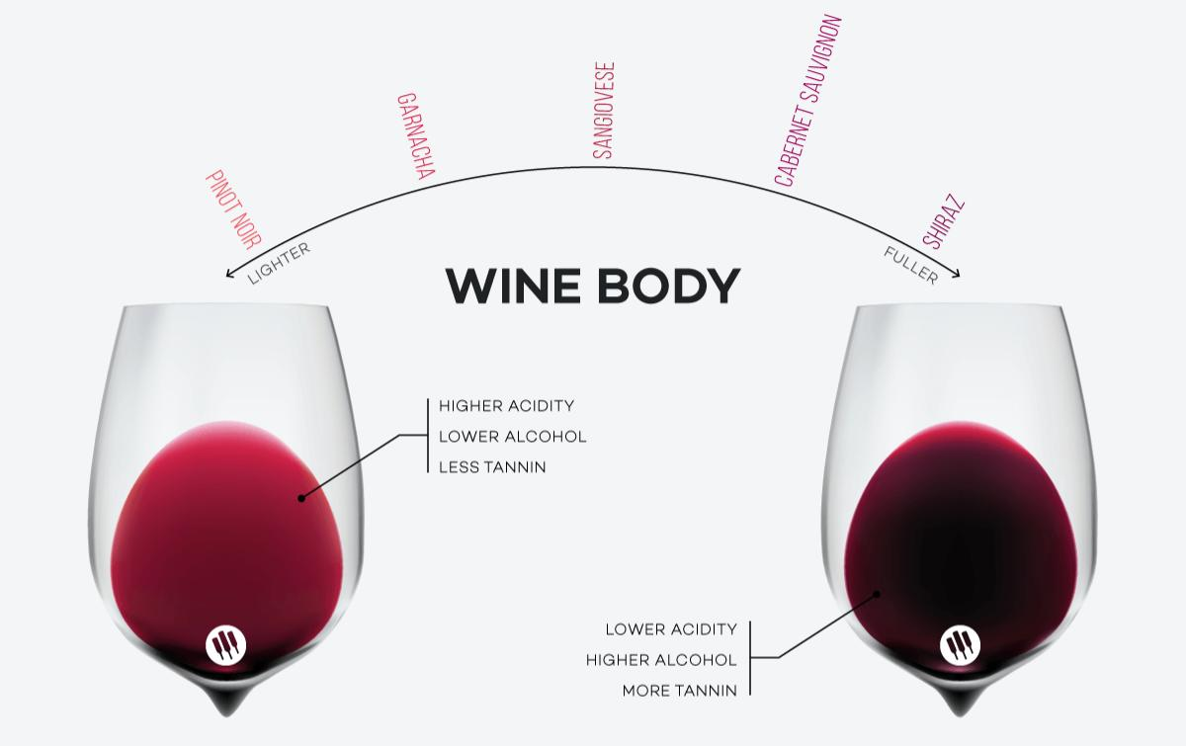

Slide 19
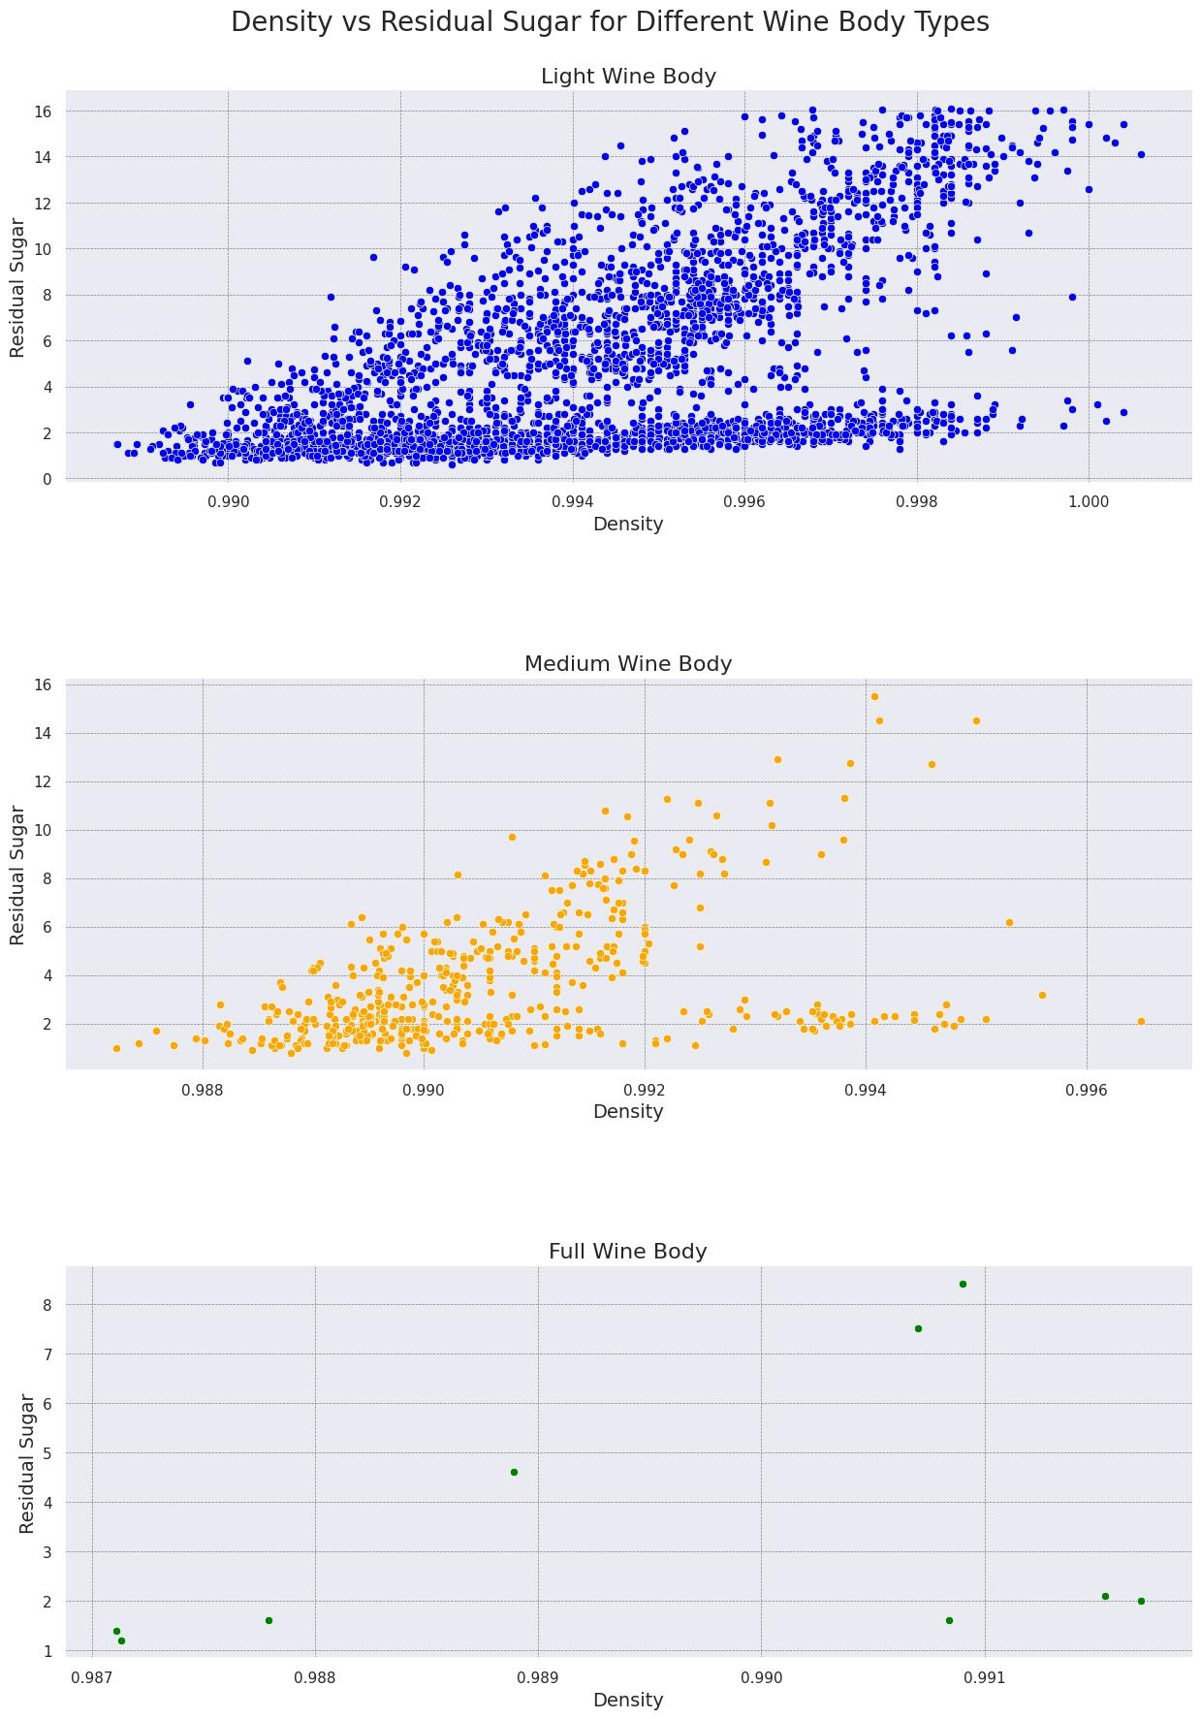
Relation between Density & Residual Sugar?
The positive correlation between residual sugar and density suggests that wines with higher residual sugar tend to have a higher body, as measured by density.
This is because residual sugar contributes to the overall weight and viscosity of the wine, making it feel heavier in the mouth.
It's important to note that body is also influenced by other factors such as alcohol content, tannins, and acidity, so residual sugar and density are not the only determinants of wine body.

Slide 20
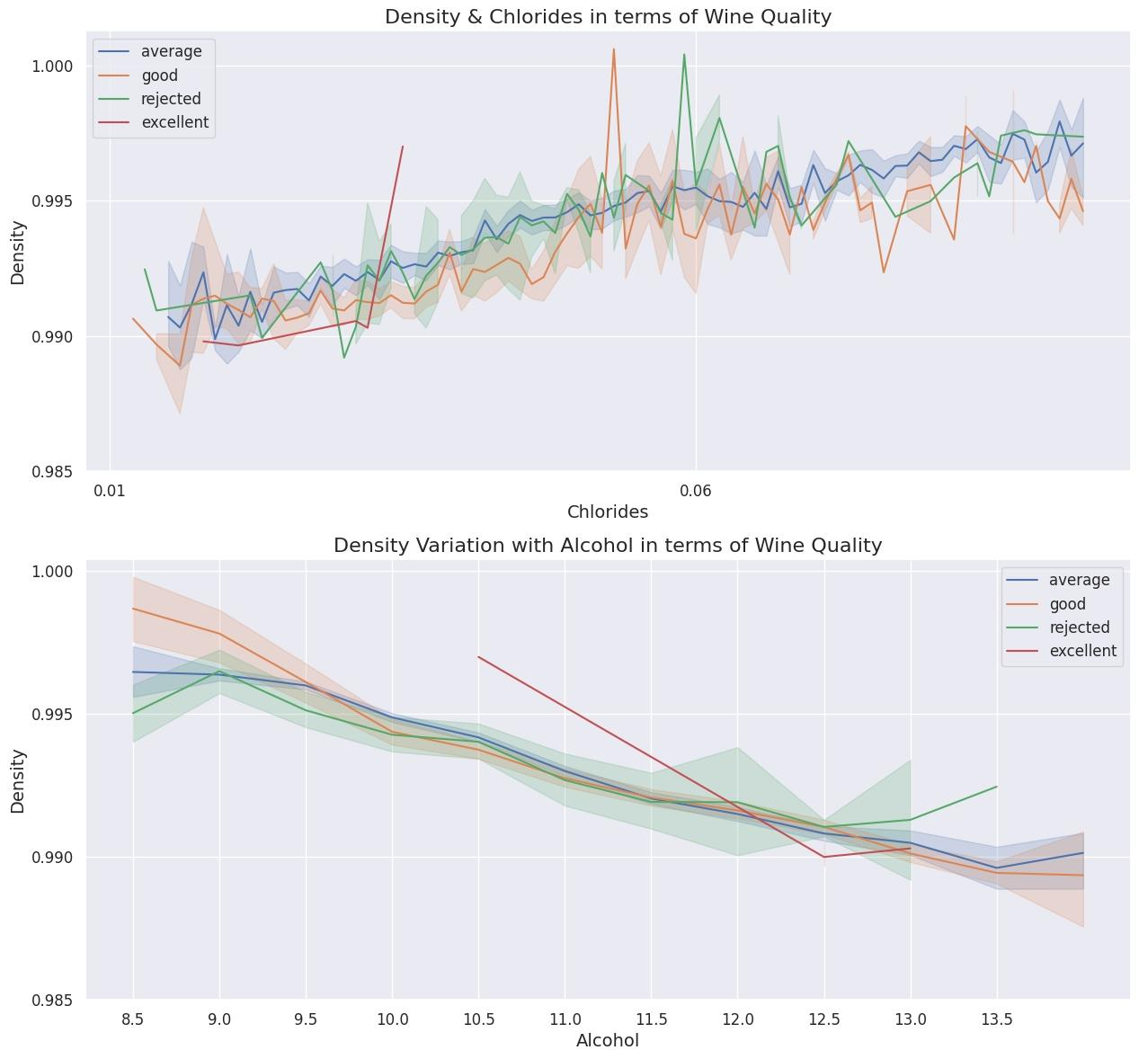
What other Factors Affecting Density
There is a positive correlation between chlorides and density, which means that wines with higher chloride content tend to have higher density. Chlorides are a type of salt that can increase the density of a solution, and thus can contribute to the density of wine.
There is a negative correlation between alcohol and density, which means that wines with higher alcohol content tend to have lower density. This can be explained by the fact that alcohol has a lower density than water, and as alcohol content increases, it dilutes the wine and lowers its overall density.

Slide 21
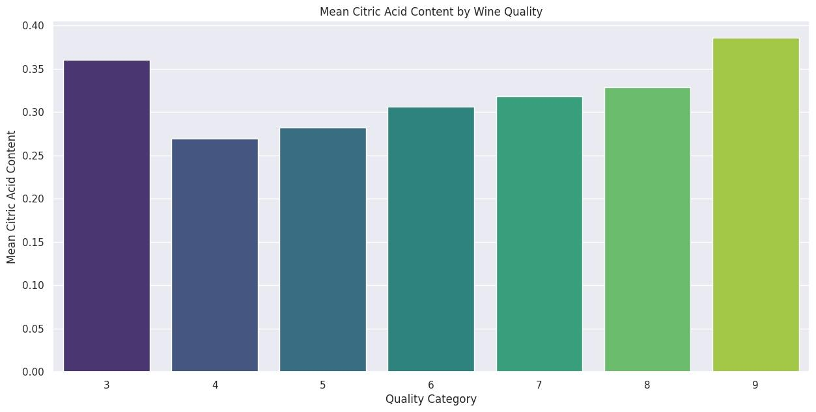
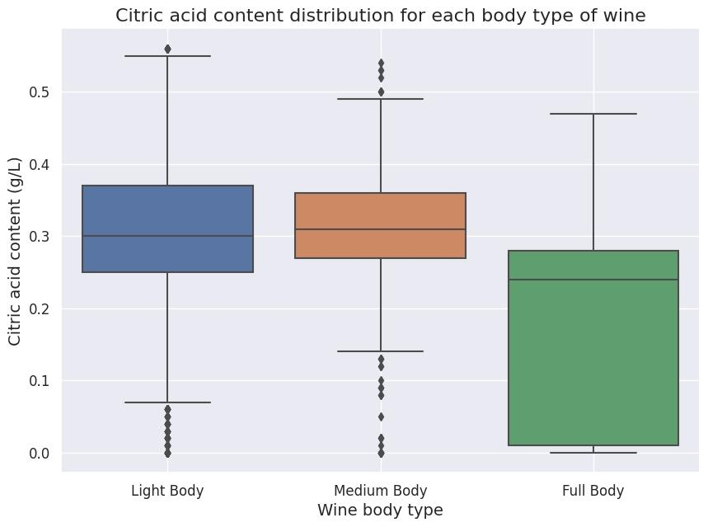
How does Citric Acid Affect the Wine?
Feature | Citric Present Mean | Citric Absent Mean | Diff
F.A | 6.94 | 6.55 | 0.38
VA | 0.30 | 0.56 | -0.256
R.S | 4.67 | 2.63 | 2.03
Chlorides | 0.047 | 0.063 | -0.01
Free So2 | 29.23 | 17.6 | 11.63
Total So2 | 116 | 49.75 | 66.42
Density | 0.99 | 0.99 | -0.001
pH | 3.22 | 3.41 | -0.18
Sulphates | 0.49 | 0.55 | -0.05
Alcohol | 10.71 | 10.77 | -0.05
Quality | 5.88 | 5.45 | 0.42

Slide 22
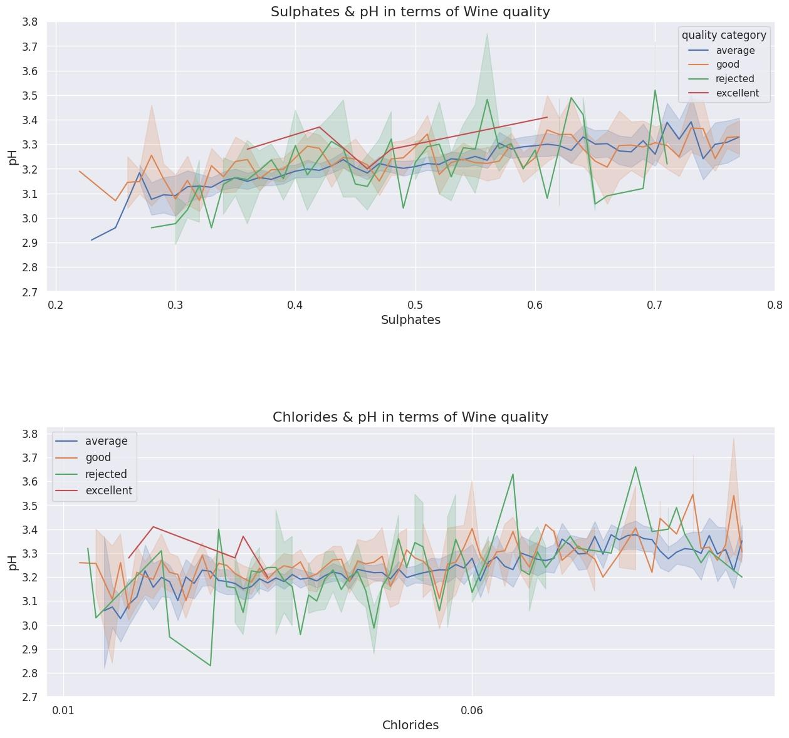
What Factors Affect the pH of Wine?
There appears to be a weak positive correlation between sulphates and pH in wine.
Similarly, there also seems to be a weak positive correlation between chlorides and pH.
It's worth noting that the correlation between these factors and pH is quite weak, and there is likely to be considerable variation in pH even among wines with similar levels of sulphates or chlorides.
Further analysis would be needed to fully understand the relationship between pH and other physicochemical properties of wine.

Slide 23
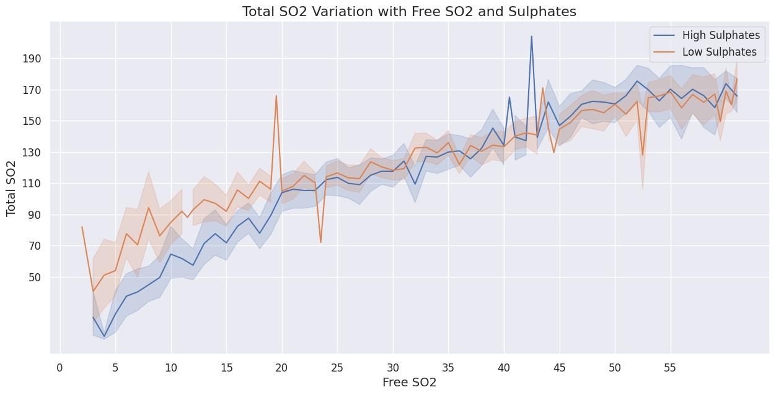
How are Sulphates Related to Total & Free SO2?

Slide 24
Can we use ML techniques to predict the quality of wine?
Machine learning techniques can be used to predict the quality of wine based on the available features.
A number of classification algorithms such as Logistic Regression, Decision Trees, K-Nearest Neighbors, Random Forest, etc can be used for this purpose.
Feature selection & feature scaling techniques can also be applied to improve the performance of the models.
Evaluation metrics such as accuracy, precision, recall, and F1-score can be used to assess the performance of the model.
In conclusion, machine learning techniques can be used to predict wine quality, and further exploration of the available models and evaluation metrics can be done to improve the accuracy of the predictions.

Slide 25
Conclusion
Control the Density & pH of wines.
How much Sulphates or Citric Acid to add will depend upon the type of wine they are making
While adding sulphates, keep a check on the Total & Free SO2 levels in wine
While adding citric acid, keep a check on pH of wine.
Small levels of Free SO2 are found in wines but as long as they do not go above the sensory threshold, its good.
Chlorides and Volatile Acidity are surely bad for wines and the lower the content of these 2, the better the wine is.

Slide 26
Limitations
We have Imbalanced Datasets currently
Only 5 Excellent wines, 809 Good wines & 2789 Average wines.
Only 61 wines which have citric acid present.
Light body(3249) vs Medium Body (489) and Full Body (Only 9)
Meat Pairing Labels - Not Available
Climate conditions where the Wine is Consumed - Not Available
Type of Wine Red/White - Not Available
Where the Wine is made will also strongly affect the Chlorides. This information is also Not Available

Slide 27
Actionable Insights
People in the U.S clearly Prefer Light to Medium Body Wines. To Enter the Market we would suggest to go ahead with either of them.
Starting with a Dry wine to enter the market is a great idea since there will be higher chances of it being liked more
Volatile Acidity above 0.7 should straight away be discarded and deeper research needed to explore factors that affect the Volatile Acidity. Citric Acid is surely helping to gain better ratings for the wine
Chlorides are pretty much like a poison to the Wines so maintaining lower levels would also be key
Maintaining a Free SO2 level of 30 and Total SO2 level of around 120 by adding the necessary amounts of sulphates would also be a key to getting the wine rated higher in Quality

Slide 28
Recommendations for further analysis
Since Vintest is looking to Launch in India, Getting the quality rating by the Local people would be a better idea since Wine-making is actually the art of Striking the right Balance of Flavours that suit the Local Taste and the Time and Weather in Which it is consumed.
There is no 1 Great wine that will be liked by all and a deeper analysis with regular feedback system would be the best solution to Actually Develop the AI Solution that Vintest is looking for.
One suggestion would be to reward the consumers for giving Feedback in some manner to encourage better Data Acquisition.

Slide 29


